Slide 1
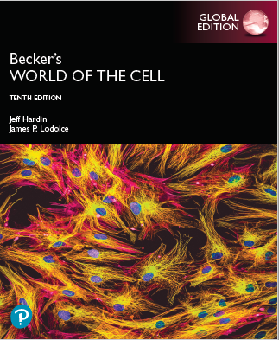
Becker’s World of the Cell
Tenth Edition, Global Edition
Chapter 12
The Endomembrane System and Protein Sorting
Lectures by Anna Hegsted, Simon Fraser University
Copyright © 2022 Pearson Education Ltd. All Rights Reserved.
Notes:
If this PowerPoint presentation contains mathematical equations, you may need to check that your computer has the following installed:
1) MathType Plugin
2) Math Player (free versions available)
3) NVDA Reader (free versions available)

Slide 2
The Endomembrane System (1 of 2)
An appreciation of eukaryotic cells depends on understanding the role of intercellular membranes and the compartmentalization of function within organelles.
Movement of lipids and proteins between organelles (called trafficking) must be tightly regulated.

Slide 3
Components of the Endomembrane System
The endoplasmic reticulum and the Golgi complex are sites for protein synthesis, processing, and sorting.
Endosomes carry and sort material brought into the cell.
Lysosomes digest ingested material and unneeded cellular components.
These form the endomembrane system.

Slide 4
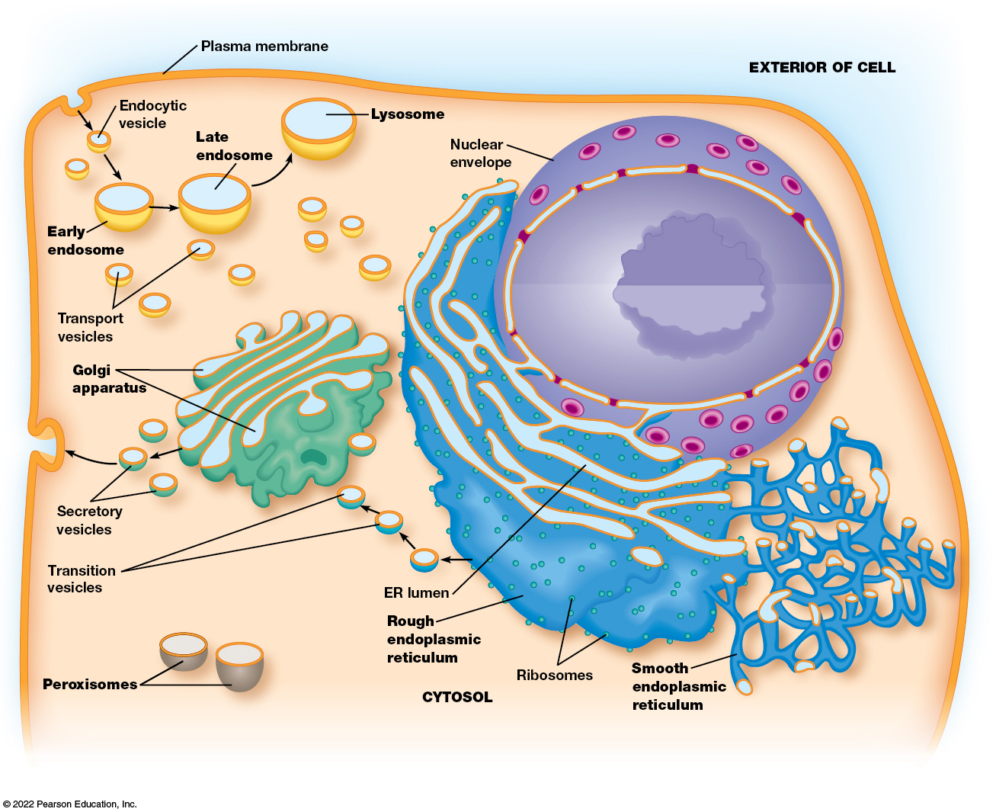
The Endomembrane System (2 of 2)
Figure 12.1 The Endomembrane System.
Notes:
Long Description:
The different components that are labeled are
a. The plasma membrane forms the outer covering of the cell and is exposed to the exterior of the cell.
b. Endocytic vesicle to an early endosome to a late endosome to a lysosome.
c. Nucleus enclosed by a nuclear envelope
d. Transport vesicles
e. Golgi apparatus to secretory vesicles
f. ER lumen in rough endoplasmic reticulum linked to transition vesicles.
g. Ribosomes looking like spots of the endoplasmic reticulum
h. Smooth endoplasmic reticulum
i. Peroxisomes

Slide 5
12.1 The Endoplasmic Reticulum
The endoplasmic reticulum (E R) is a continuous network of flattened sacs, tubules, and vesicles through the cytoplasm of a eukaryotic cell.
The membrane-bound sacs are called E R cisternae (singular: E R cisterna), and the space inside them is the ER lumen.

Slide 6
Functions of the E R
The enzymes associated with the E R are involved in bio synthesis of proteins for:
Incorporation into the plasma membrane or into the organelles of the endomembrane system
Export from the cell
The E R is also involved in lipid synthesis.

Slide 7
The Two Basic Kinds of Endoplasmic Reticulum Differ in Structure and Function
Rough endoplasmic reticulum (rough E R) is characterized by ribosomes on the cytosolic side of the membrane.
A subdomain of rough E R, the transitional elements (T Es), play a role in the formation of transition vesicles that shuttle lipids and proteins from the E R to the Golgi complex.
Smooth E R lacks ribosomes and has other roles in the cell involving the processing and storage of nonproteins.

Slide 8
Rough and Smooth E R Are Easily Distinguished
Rough E R membranes form large flattened sheets.
Smooth E R membranes form tubular structures.
Transitional elements of the rough E R are an exception; they resemble the smooth E R.
The lumenal spaces of rough and smooth E R are continuous.

Slide 9
Variation in Amounts of Rough and Smooth E R
Both types of E R are present in most eukaryotic cells, but there is variation in the relative amounts.
Cells involved in synthesis of secretory proteins have prominent rough E R networks.
Cells producing steroid hormones tend to have extensive networks of smooth E R.

Slide 10
Rough E R Is Involved in the Biosynthesis and Processing of Proteins (1 of 2)
Ribosomes on the cytosolic side of the rough E R membrane synthesize both membrane-bound and soluble proteins for the endomembrane system.
Newly synthesized proteins are inserted into the endomembrane system through a pore complex as they are synthesized (cotranslationally).

Slide 11
Rough E R Is Involved in the Biosynthesis and Processing of Proteins (2 of 2)
Rough E R is the site for
The initial steps of addition of carbohydrates to glycoproteins
The folding of polypeptides
Recognition and removal of misfolded proteins
Assembly of multimeric proteins

Slide 12
Rough E R Has a Role in Quality Control
Proteins that are incorrectly folded, modified, or assembled are exported for degradation.
Degradation occurs in cytosolic proteasomes.

Slide 13
Smooth E R Is Involved in Drug Detoxification, Carbohydrate Metabolism, Calcium Storage, and Steroid Biosynthesis
The functions of smooth E R differ from that of rough E R.
Smooth E R is primarily involved in processing or storing nonprotein molecules within cells.

Slide 14
Drug Detoxification
Drug detoxification often involves hydroxylation.
Adding hydroxyl groups to hydrophobic drugs increases their solubility, making them easier to excrete from the body.
Hydroxylation is catalyzed by a member of the cytochrome P-450 family of proteins, also called monooxygenases.

Slide 15
Hydroxylation Occurs via Electron Transport
Electrons from N A D P H or N A D H are transferred to a heme group in cytochrome P-450.
An electron is donated to O₂, where one oxygen atom forms H₂O and the other is added to the substrate as a hydroxyl group:
Where R is the drug being hydroxylated.

Slide 16
Drug Tolerance
Injection of phenobarbital into rats causes rapid increases in the barbiturate-detoxifying enzymes and a proliferation of smooth E R.
This means that higher doses of the drug are needed to achieve the same effect, a phenomenon known as tolerance.
The enzymes involved can decrease the effectiveness of other drugs as well by hydroxylating them.

Slide 17
Drug Detoxification in the Smooth E R
Another cytochrome P-450 is part of a complex called aryl hydrocarbon hydroxylase, which metabolizes polycyclic hydrocarbons.
The products can be more toxic than the original compounds; some are associated with spontaneous cancers in mice.
Cigarette smoke is a potent inducer of aryl hydrocarbon hydroxylase.

Slide 18
Pharmacogenetics
Differences in activities and side effects of certain medications can result from differences in presence or activity of particular cytochrome P-450 genes in different patients.
This field of study, called pharmacogenetics, investigates how inherited differences in genes, like P-450, can lead to differential responses to drugs and medications.

Slide 19
Carbohydrate Metabolism (1 of 2)
Smooth E R in liver cells is involved in breakdown of stored glycogen; it contains glucose-6-phosphatase, an enzyme unique to smooth E R.
Glucose-6-phosphatase hydrolyzes the phosphate from glucose-6-phosphate to form free glucose:

Slide 20
Carbohydrate Metabolism (2 of 2)
The liver stores glucose as glycogen in granules associated with smooth E R.
When glucose is needed by the body, glycogen is broken down by phosphorolysis, producing glucose-6-phosphate.
This must be converted to free glucose in order to leave the cell and enter the bloodstream.

Slide 21
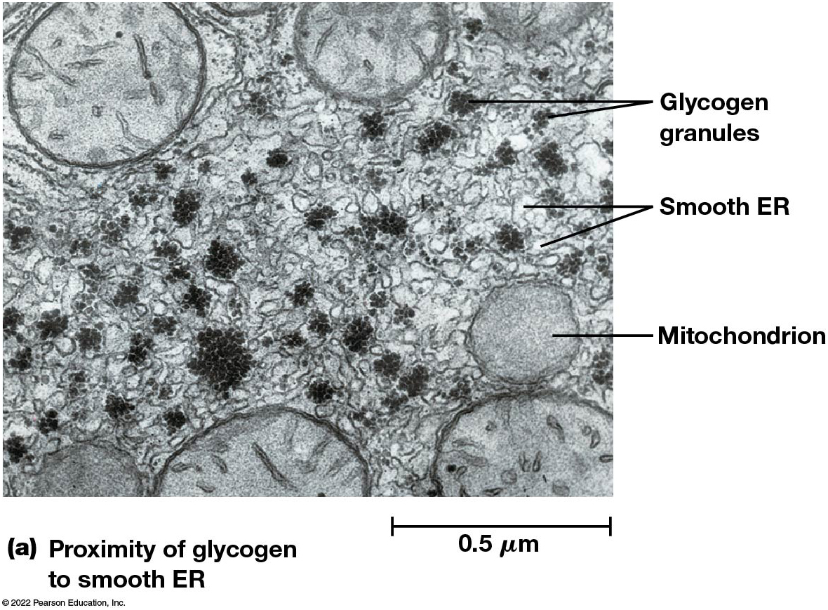
The Role of the Smooth E R in the Catabolism of Liver Glycogen (1 of 2)
Figure 12.2 The Role of the Smooth E R in the Catabolism of Liver Glycogen.
Notes:
Long Description:
The process of glycogen breakdown in liver cell is as below:
1. Glycogen granules in the presence of glycogen phosphorylase give Glucose hyphen one hyphen P with hexagon and a phosphate bond structure.
2. Glucose hyphen one hyphen P in the presence of Phosphoglucomutase gives Glucose hyphen six hyphen P with hexagon and a phosphate bond structure.
3. Glucose hyphen six hyphen P in the presence of Glucose hyphen six hyphen phosphatase that is associated with smooth endoplasmic reticulum gives Glucose with a hexagon structure and inorganic phosphate.
4. Glucose is transmitted out of the liver by the glucose transporter present in the plasma membrane and glucose is seen in the blood.

Slide 22
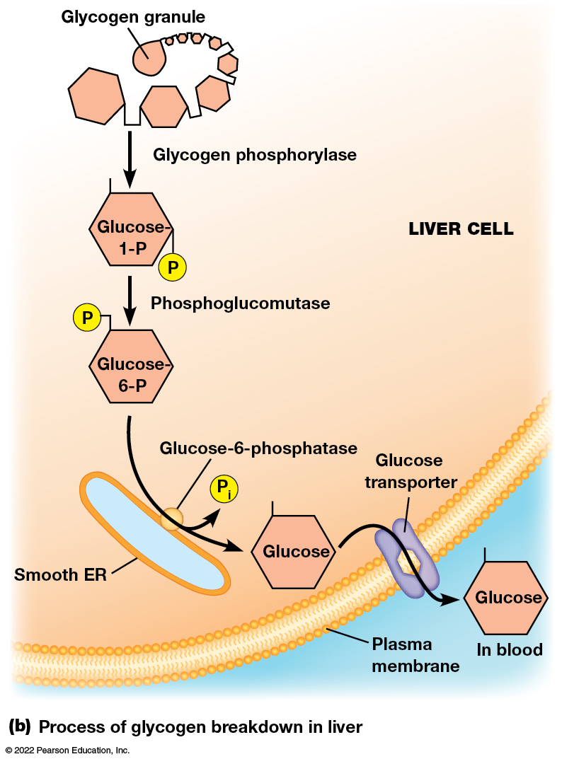
The Role of the Smooth E R in the Catabolism of Liver Glycogen (2 of 2)
Figure 12.2 The Role of the Smooth E R in the Catabolism of Liver Glycogen.
Notes:
Long Description:
The process of glycogen breakdown in liver cell is as below:
1. Glycogen granules in the presence of glycogen phosphorylase give Glucose hyphen one hyphen P with hexagon and a phosphate bond structure.
2. Glucose hyphen one hyphen P in the presence of Phosphoglucomutase gives Glucose hyphen six hyphen P with hexagon and a phosphate bond structure.
3. Glucose hyphen six hyphen P in the presence of Glucose hyphen six hyphen phosphatase that is associated with smooth endoplasmic reticulum gives Glucose with a hexagon structure and inorganic phosphate.
4. Glucose is transmitted out of the liver by the glucose transporter present in the plasma membrane and glucose is seen in the blood.

Slide 23
Calcium Storage
The sarcoplasmic reticulum of muscle cells is an example of smooth E R that specializes in calcium storage.
The E R lumen contains high concentrations of calcium-binding proteins.
Calcium ions are pumped into the E R by A T P-dependent calcium A T Pases and are released when needed for muscle contraction.

Slide 24
Steroid Biosynthesis (1 of 2)
Smooth E R in some cells is the site of cholesterol and steroid hormone synthesis.
Large amounts of smooth E R are found in cells that synthesize these.
Smooth E R has also been found associated with plastids in some plants and may be involved in plant hormone synthesis.

Slide 25
Steroid Biosynthesis (2 of 2)
Cholesterol, cortisol, and steroid hormones share a four-ring structure but differ in the number and arrangement of carbon side chains and hydroxyl groups.
Hydroxymethylglutaryl-CoA reductase (H M G -CoA reductase) is the committed step in cholesterol biosynthesis.
It is found in smooth E R of liver cells and is targeted by cholesterol-lowering drugs called statins.

Slide 26
The E R Plays a Central Role in the Biosynthesis of Membranes
In eukaryotic cells, the E R is the primary source of membrane lipids, with a few exceptions.
Mitochondria synthesize phosphatidylethanolamine.
Peroxisomes synthesize cholesterol.
Chloroplasts contain enzymes for chloroplast-specific lipids.

Slide 27
Membrane Biosynthesis (1 of 2)
Fatty acids for membrane phospholipids are synthesized in the cytoplasm and incorporated into the E R membrane on the cytosolic side.
They are transferred to the lumenal side of the bilayer by enzymes called phospholipid translocators (flippases).
The type of phospholipid molecules transferred across the membrane depends on the particular translocator present, leading to membrane asymmetry.

Slide 28
Membrane Biosynthesis (2 of 2)
The distinct composition of cytosolic and lumenal monolayers established in the E R is transferred to other cellular membranes.
Movement of phospholipids from E R to mitochondria, chloroplasts, or peroxisomes is problematic.
Phospholipid exchange proteins (phospholipid transfer proteins) convey specific phospholipids to these organelles.

Slide 29
Composition of the E R and Plasma Membranes of Rat Liver Cells
Table 12.1 Composition of the E R and Plasma Membranes of Rat Liver Cells
Membrane Components | ER Membrane | Plasma Membrane
Membrane components as % of membrane by weight
Carbohydrate | 10 | 10
Protein | 62 | 54
Total lipid | 27 | 36
Membrane lipids as % of total lipids by weight
Phosphatidylcholine | 40 | 24
Phosphatidylethanolamine | 17 | 7
Phosphatidylserine | 5 | 4
Cholesterol | 6 | 17
Sphingomyelin | 5 | 19
Glycolipids | trace | 7
Other lipids | 27 | 22
Notes:
Long Description:
Membrane Components
ER Membrane
Plasma Membrane
Membrane components as % of membrane by weight
Carbohydrate
10
10
Protein
62
54
Total lipid
27
36
Membrane lipids as % of total lipids by weight
Phosphatidylcholine
40
24
Phosphatidylethanolamine
17
7
Phosphatidylserine
5
4
Cholesterol
6
17
Sphingomyelin
5
19
Glycolipids
trace
7
Other lipids
27
22

Slide 30
12.2 The Golgi Apparatus
The Golgi apparatus (or Golgi complex) is functionally and physically linked to the E R.
Here, glycoproteins and membrane lipids from the E R undergo further processing and are sorted and packaged for transport.
Thus the Golgi complex plays a central role in membrane and protein trafficking in eukaryotic cells.

Slide 31
The Golgi Apparatus Consists of a Series of Membrane-Bounded Cisternae
The Golgi apparatus is a series of flattened membrane-bounded cisternae.
A series of cisternae, usually three to eight, is called a Golgi stack.
Some cells have one large stack, and others, especially secretory cells, have hundreds or thousands of stacks.

Slide 32
Transport Vesicles
Both E R and the Golgi complex are surrounded by numerous vesicles that carry lipids and proteins from the ER to the Golgi complex and then to various destinations in the cell.
The Golgi complex lumen (intracisternal space) is part of the endomembrane system.

Slide 33
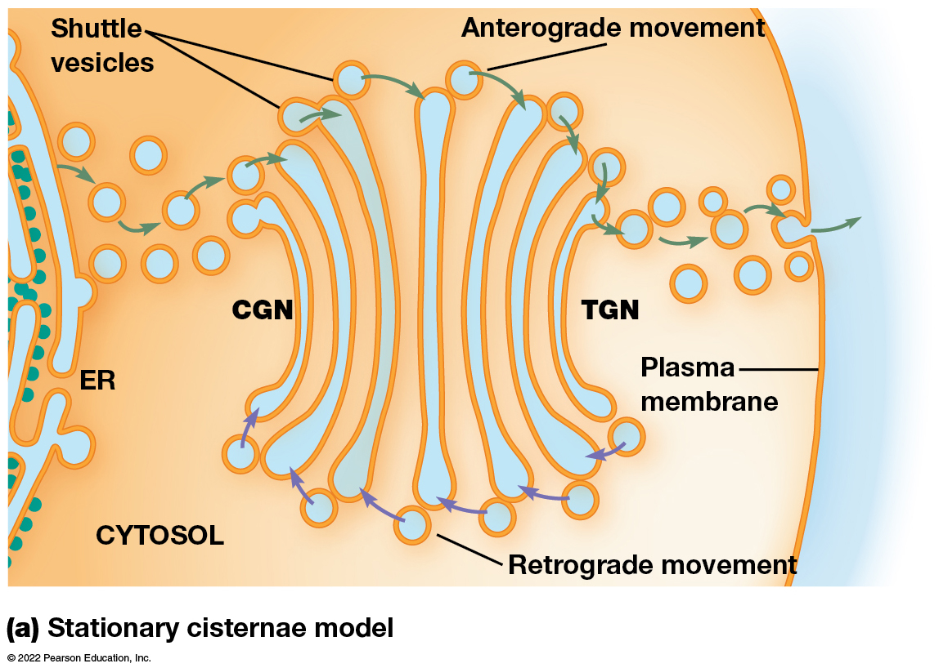
Golgi Structure (1 of 2)
Figure 12.4 Two Models for Movement Through the Golgi.
Notes:
Long Description:
a. Stationary cisternae model:
Shuttle vesicles are found on the tip of the Golgi compartments. The shuttle vesicles carry material forward from ER to successive golgi compartments, which remain in place.
There is anterograde movement from C G N to T G N through the shuttle vesicles that open outside the cell through the plasma membrane. The cell is covered by plasma membrane. There is retrograde movement from T G N to C G N.

Slide 34
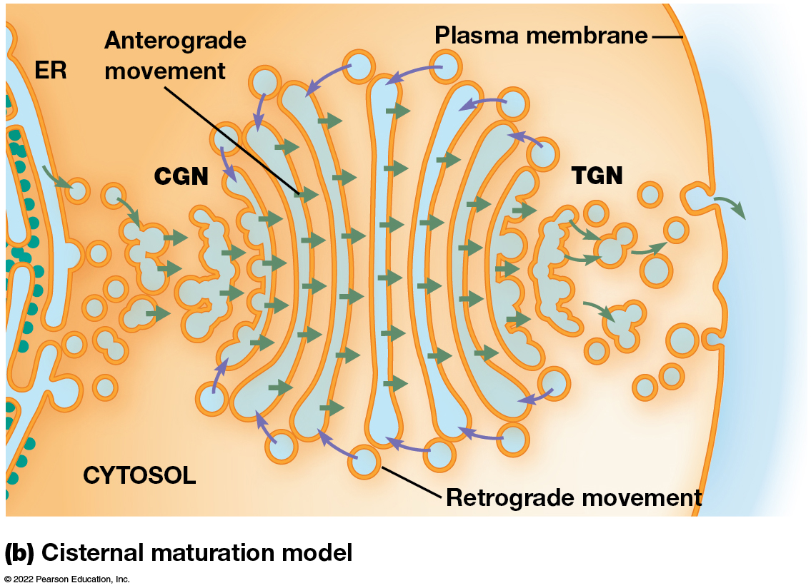
Golgi Structure (2 of 2)
Figure 12.4 Two Models for Movement Through the Golgi.
Notes:
Long Description:
b. Cisternal maturation model:
The retrograde movement is at the ends of the Golgi apparatus from T G N to C G N. The anterograde movement is from CGN to TGN through the cisternae of the Golgi stack. It opens to the exterior of the cell through the plasma membrane. ER moves from C G N to T G N and then released outside the cell through plasma membrane.

Slide 35
The Two Faces of the Golgi Stack
Each Golgi stack has two distinct sides, or faces.
The cis face is oriented toward the E R, and the Golgi compartment on this side is called the cis-Golgi network (C G N).
The opposite side is called the trans face, and the compartment on this side is called the trans-Golgi network (T G N).

Slide 36
The Golgi Network
Proteins and lipids leave the Golgi in transport vesicles that continuously bud from the tips of the T G N.
Between the T G N and C G N are medial cisternae, where much of the processing of proteins occurs.
Each compartment are biochemically and functionally distinct, containing specific receptor proteins unique to each portion of the network.

Slide 37
Two Models Account for the Flow of Lipids and Proteins Through the Golgi Apparatus
Two models have been proposed to explain the movement of lipids and proteins from the Golgi.
These are
The stationary cisternae model
The cisternal maturation model

Slide 38
The Stationary Cisternae Model
In this model, each cisterna in the Golgi stack is a stable structure.
Transport of materials from one cisterna to another is mediated by shuttle vesicles.
These bud off from one cisterna and fuse with the next cisterna in a cis-to-trans sequence.

Slide 39
The Cisternal Maturation Model
In this model, the Golgi cisternae are transient compartments.
These gradually change from C G N through medial cisternae to TGN.
Enzymes not needed in later compartments are returned to earlier compartments in vesicles.

Slide 40
The Models Are Not Mutually Exclusive
Both models involve the formation of transport vesicles containing sorted cargo targeted for various destinations.
Experimental evidence suggests that these models are not mutually exclusive.
Experiments involve tracking the movement of substances between the compartments and time-lapse fluorescence microscopy.

Slide 41
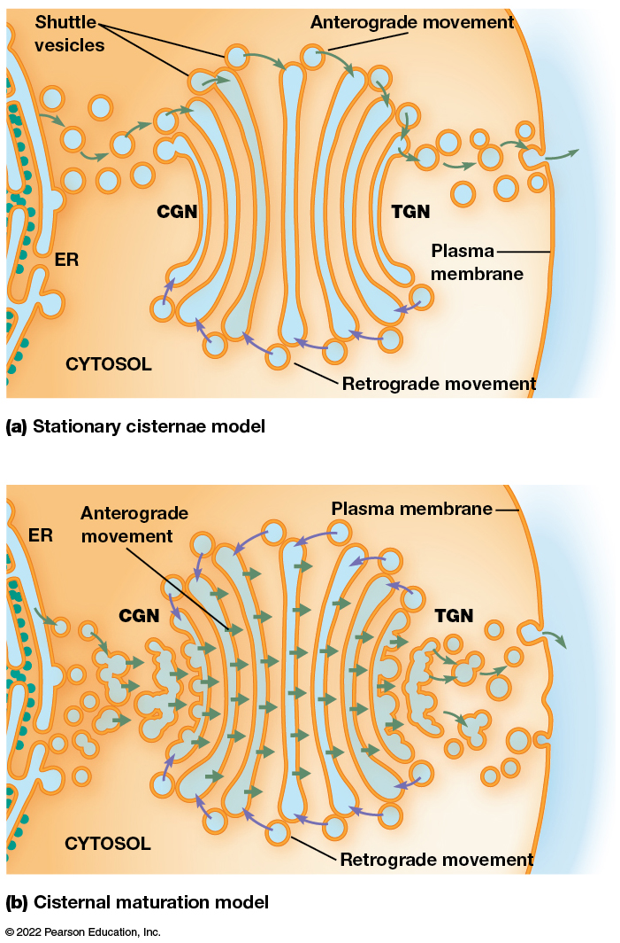
Two Models for Movement Through the Golgi
Figure 12.4 Two Models for Movement Through the Golgi.
Notes:
Long Description:
Stationary cisternae model:
Shuttle vesicles are found on the tip of the Golgi compartments. The shuttle vesicles carry material forward from ER to successive golgi compartments, which remain in place.
There is anterograde movement from C G N to T G N through the shuttle vesicles that open outside the cell through the plasma membrane. The cell is covered by plasma membrane. There is retrograde movement from T G N to C G N.
Cisternal maturation model:
The retrograde movement is at the ends of the Golgi apparatus from T G N to C G N. The anterograde movement is from CGN to TGN through the cisternae of the Golgi stack. It opens to the exterior of the cell through the plasma membrane. ER moves from C G N to T G N and then released outside the cell through plasma membrane.

Slide 42
Anterograde and Retrograde Transport (1 of 2)
Movement of material toward the plasma membrane is called anterograde transport.
As a secretory granule fuses with the plasma membrane and discharges its contents (exocytosis), a bit of membrane from the E R becomes part of the plasma membrane.
This flow of lipids toward the plasma membrane must be balanced.

Slide 43
Anterograde and Retrograde Transport (2 of 2)
Retrograde transport is the flow of vesicles from Golgi cisternae back to the E R.
This allows the cell to balance the flow of lipids toward the plasma membrane.
It also ensures a supply of materials for forming new vesicles.

Slide 44
12.3 Roles of the E R and Golgi Apparatus in Protein Processing
Protein processing in the E R and Golgi apparatus includes:
Protein folding,
Quality control, and
Glycosylation, the addition of carbohydrate side chains to proteins to form glycoproteins.

Slide 45
Two General Kinds of Glycosylation
N-linked glycosylation (N-glycosylation) involves the addition of an oligosaccharide to the nitrogen atom of certain asparagine residues.
O-linked glycosylation involves addition of the oligosaccharide to the oxygen atom on the hydroxyl group of certain serine, threonine, and rarely tyrosine residues.

Slide 46
Protein Folding and Quality Control Take Place Within the E R
Polypeptides fold into their final shapes and assemble with other polypeptides to form multisubunit proteins in the E R lumen.
Molecular chaperones facilitate these folding and assembly events.

Slide 47
B i P: an Hsp70 Chaperone Protein
B i P binds the hydrophobic region of a polypeptide, which prevents aggregation.
B i P releases the polypeptide, accompanied by A T P hydrolysis, allowing the protein to fold. This folding can be aided by other chaperone proteins.
If the protein folds correctly, the hydrophobic regions are buried and B i P cannot bind.
If the protein folds incorrectly, B i P rebinds the hydrophobic residues and the process is repeated.

Slide 48
Disulfide Bonds
Protein disulfide isomerase is an enzyme that leads to the formation (and breakage) of disulfide bonds between cysteines.
Disulfide bonds begin forming before synthesis of the polypeptide is complete. Allowing for the formation and breakage of disulfide bonds until the most stable arrangement can be found.

Slide 49
Protein Quality Control Mechanisms
The unfolded protein response (U P R) uses sensor molecules in the E R membrane to detect misfolded proteins. The sensors activate signaling pathways that shut down the production of protein except for those required for protein folding and degradation.
E R-associated degradation (E R A D) recognizes misfolded or unassembled proteins and exports them to the cytosol to be degraded by proteasomes.

Slide 50
Initial Glycosylation Occurs in the E R
The initial steps of N-glycosylation take place on the cytosolic surface of the E R membrane.
Later steps take place in the E R lumen.
All carbohydrate side chains initially have a common core oligosaccharide consisting of two units of N-acetylglucosamine, nine mannose units, and three glucose units.

Slide 51
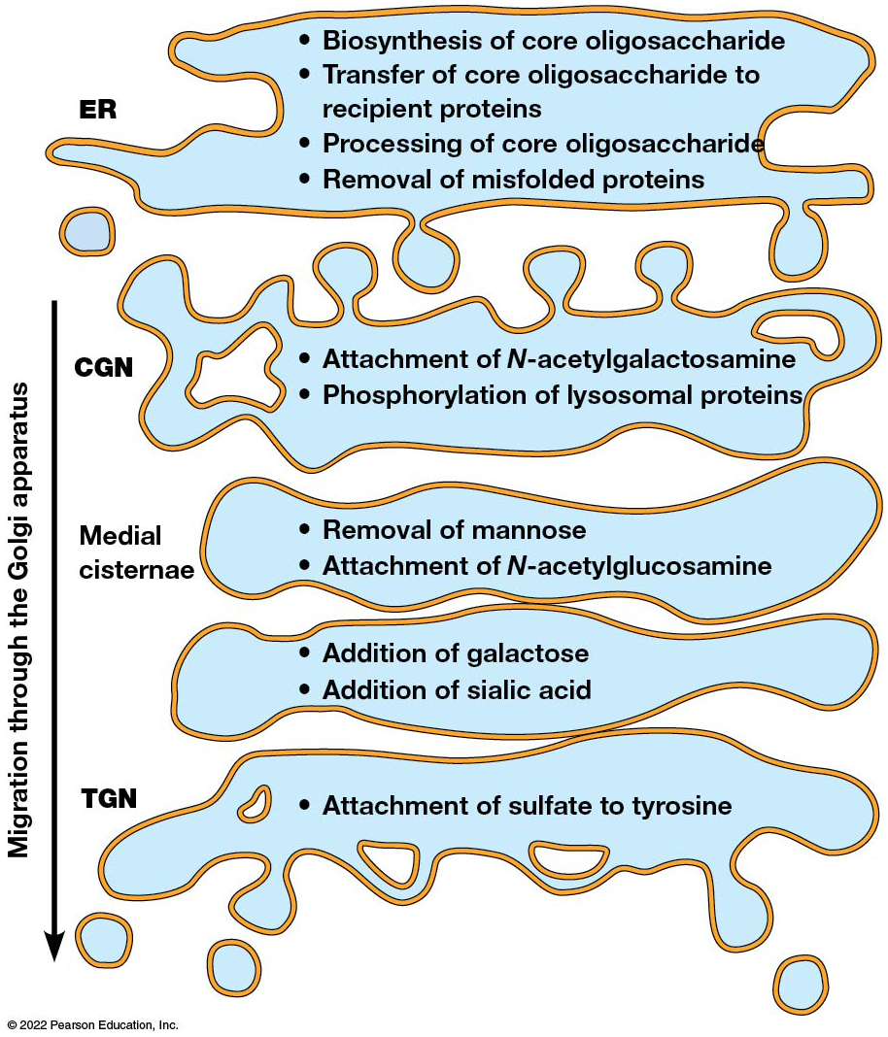
Compartmentalization of the Steps of Glycosylation and Subsequent Modification of Proteins
Figure 12.5 Compartmentalization of the Steps of Glycosylation and Subsequent Modification of Proteins.
Notes:
Long Description:
The process in the E R is as below:
• Biosynthesis of core oligosaccharide
• Transfer of core oligosaccharide to recipient proteins
• Processing of core oligosaccharide
• Removal of misfolded proteins
The process in the C G N is as below:
• Attachment of N hyphen acetylgalactosamine
• Phosphorylation of lysosomal proteins
The process in the medial cisternae is as below:
• Removal of mannose
• Attachment of N hyphen acetylglucosamine
• Addition of galactose
• Addition of sialic acid
The process in the T G N is as below:
• Attachment of sulfate to tyrosine

Slide 52
Steps of Glycosylation (1 of 2)
Glycosylation begins as dolichol phosphate, an oligosaccharide carrier, is inserted into the E R membrane.
GlcNAc and mannose groups are then added to the phosphate group.
The growing core oligosaccharide is translocated to the ER lumen by a flippase.

Slide 53
Steps of Glycosylation (2 of 2)
Once inside the lumen, more mannose and glucose are added.
The completed core oligosaccharide is transferred from dolichol to the asparagine residue of the recipient protein.
The core oligosaccharide attached to the protein is trimmed and modified.

Slide 54
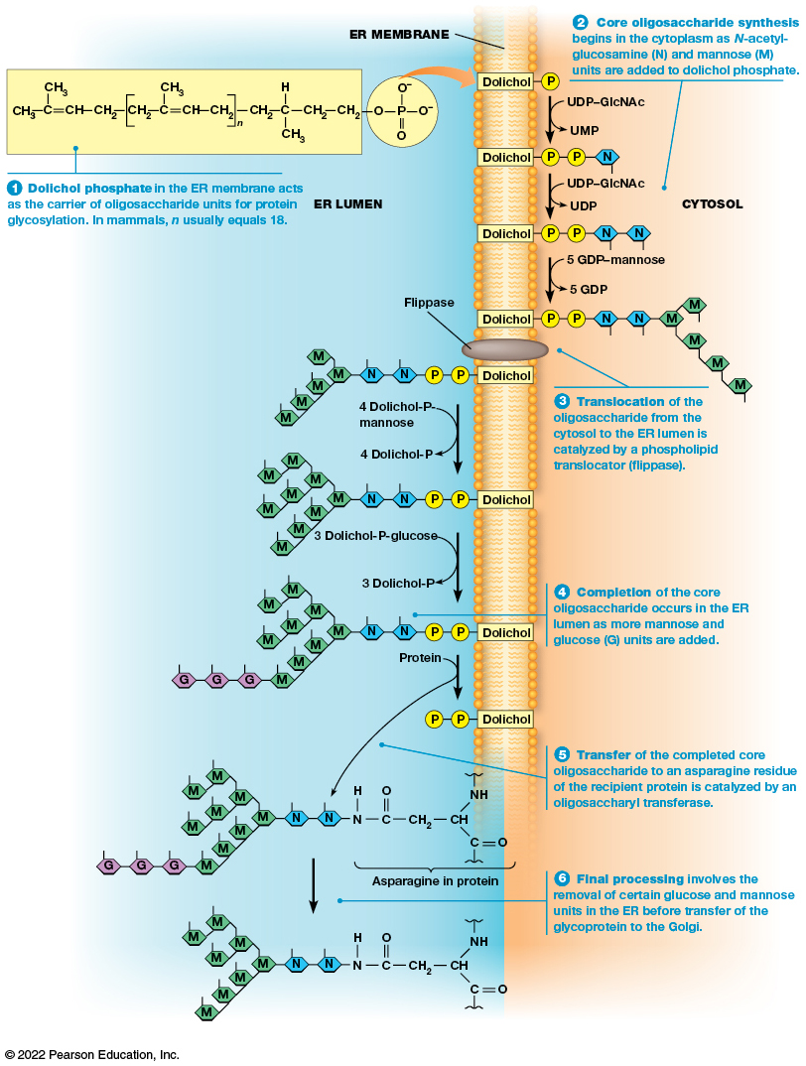
N-Linked Glycosylation of Proteins in the E R
Figure 12.6 N-Linked Glycosylation of Proteins in the E R.
Notes:
Long Description:
1. In ER lumen: Dolichol phosphate in the E R membrane acts as the carrier of oligosaccharide units for protein glycosylation. In mammals, n usually equals 18. The structure of dolichol is two C H subscript 3 each having with C double bond C H single bond C H subscript 2 single bond open square bracket C H subscript 2 single bond C single bond C H subscript 3 double bond C H single bond C H subscript 2 close square bracket base n single bond C H subscript 2 single bond C having three single bonds with H, C H subscript 3 and C H subscript 2 single bond C H subscript. This is liked with P of phosphate with 2 O negative, one O single bond, and one double bond with O.
2. In cytosol: Core oligosaccharide synthesis begins in the cytoplasm as N hyphen acetylglucosamine (N) and mannose (M) units are added to dolichol phosphate.
The following conversions happen:
a. Dolichol P to Dolichol P P N while U D P hyphen G l c N A c to U M P happens.
b. Dolichol P P N to Dolichol P P N N while U D P hyphen G l c N A c to U D P happens.
c. Dolichol P P N N to Dolichol P P N N five M molecules while five G D P hyphen mannose to five G D P happens.
3. In ER lumen: Translocation of the oligosaccharide from the cytosol to the E R lumen is catalyzed by a phospholipid translocator (flippase).
The following conversions happen
a. Dolichol P P N N five M molecules to Dolichol P P N N nine M molecules while four Dolichol hyphen P hyphen mannose is converted to four dolichol hyphen P.
b. Dolichol P P N N nine M molecules to Dolichol P P N N nine M molecules three G while three Dolichol hyphen P hyphen glucose is converted to three Dolichol hyphen P.
4. Completion of the core oligosaccharide occurs in the ER lumen as more mannose and glucose (G) units are added.
a. Structure of protein has the asparagine in protein two N nine M three G.
5. Transfer of the completed core oligosaccharide to an asparagine residue of the recipient protein is catalyzed by an oligosaccharyltransferase.
a. Structure of asparagine in protein is C H has three single bond with N H, C double bond O and C H subscript 2 single bond C double bond O single bond N single bond H.
6. Final processing involves the removal of certain glucose and mannose units in the E R before transfer of the glycoprotein to the Golgi.
a. The protein structure becomes C H has three single bond with N H, C double bond O and C H subscript 2 single bond C double bond O single bond N single bond H two N and nine M.

Slide 55
Cotranslational Glycosylation
Usually the oligosaccharide is added to the recipient protein as the polypeptide is being synthesized.
This is called cotranslational glycosylation.
It helps to promote proper protein folding.

Slide 56
Two Proteins Assist with Proper Folding
Two E R proteins, calnexin (C N X) and calreticulin (C R T), bind to monoglucosylated glycoproteins and promote proper folding.
This occurs via a complex that includes a thiol reductase known as E R p57.
The complex dissociates and the final glucose is removed by glucosidase Ⅱ.

Slide 57
Proper Folding in the E R
A glucosyl transferase, U G G T (U D P-glucose:glycoprotein glucotransferase), binds to improperly folded proteins.
It adds back a single glucose unit, making the protein a substrate for C N X / C R T binding.
Once proper conformation is achieved, UGGT no longer binds the new glycoprotein, which moves on to the Golgi.

Slide 58
Further Glycosylation Occurs in the Golgi Apparatus
Further processing of N-glycosylated proteins occurs in the Golgi complex as the glycoproteins move from the cis face through to the trans face.
These terminal glycosylations are variable and create great diversity.
Terminal glycosylation involves the removal of a few units of the core oligosaccharide and sometimes nothing more.

Slide 59
Terminal Glycosylation
In some cases, more complex oligosaccharides are generated by adding G l c N A c or other monosaccharides.
Sometimes galactose units are added by galactosyl transferase.
The E R and Golgi contain hundreds of different glycosyl transferases.

